Slide 1
FIRST Update
Jason Sparkman
May 16, 2019
Notes:
The final item I want to go over with you is the new FIRST system that will be replacing DARS

Slide 2
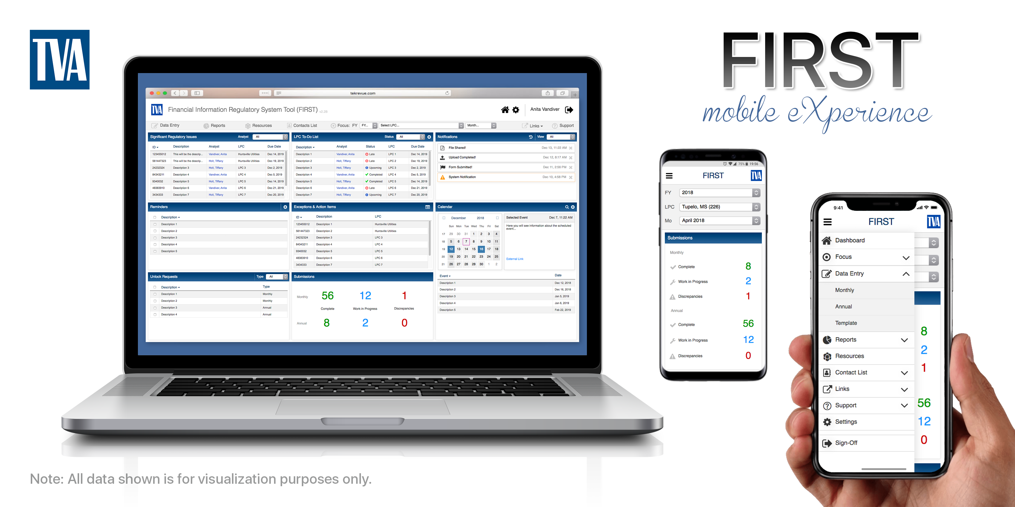
Financial Information Regulatory System Tool
Notes:
Here is just a visual representation of what the system is going to look like
I also wanted to go ahead and start getting you all familiar with the acronym FIRST, since as you all know – if there’s one thing we love at TVA, it’s an acronym

Slide 3
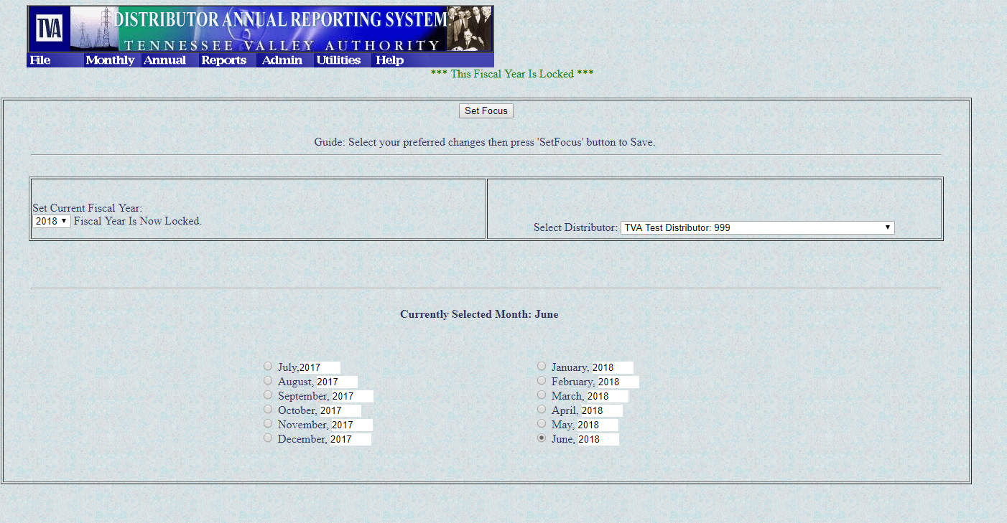
What is FIRST Replacing?
Notes:
- Here’s a screen you are all very familiar with – this is what the “dashboard” looked like on DARS – it just kind of looks outdated, doesn’t it?

Slide 4
DARS Historical Data
Distributor Annual Reporting System (DARS) is a 20+ year-old in-house developed application
DARS is a financial reporting tool for LPC’s to provide data to TVA
The platform is not mobile
Actuate has announced the end of the useful life of program that supports DARS
Notes:
Some historical data – DARS is over 20 years old – it was developed in-house as a financial reporting tool for Local Power Companies
The platform is not mobile, and it really only works well with Internet Explorer
Actuate which is the software company that supports DARS has announced the end of the useful life of the program that supports DARS
********************************************************************************************************************
- So, DARS has been a good.. Ok, maybe decent.. System for a long time, but it’s reached the end of it’s life

Slide 5
Project Scope: To build a technical uplift of DARS with enhanced capabilities for auditing and data sharing
Enhanced Capabilites:
  Automatic saving
  Identification of outliers/exceptions
  Customizable Dashboard
  Mobile Access (!!)
  Footnote at item level or monthly report
  Improved reporting
  Integration with ESS, ECM, Power Billing, etc.
Notes:
So, as a team we started out with a project scope – which was to design and build a technical uplift of DARS with enhanced capabilities
**********************************************************************************************************************************************************
Some of those enhanced capabilities are:
Automatic Saving – I think every single one of us have been burned by that at some point, have we not?
It will be able to identify outliers and exceptions within data and prompt you to review it before submission
It will feature a customizable dashboard that we will go over in more detail shortly
It will be mobile accessible!
You will be able to footnote items at both the montly level, or on the page that the actual data is on, versus consolidating all of it on page 33
The reporting should feel improved – it’s going to be easier to navigate – an example would be the Bonds pages – it will not feel near as clunky as it has previously
And we hope to fully integrate with other TVA systems such as ESS, ECM, and Power Billing

Slide 6
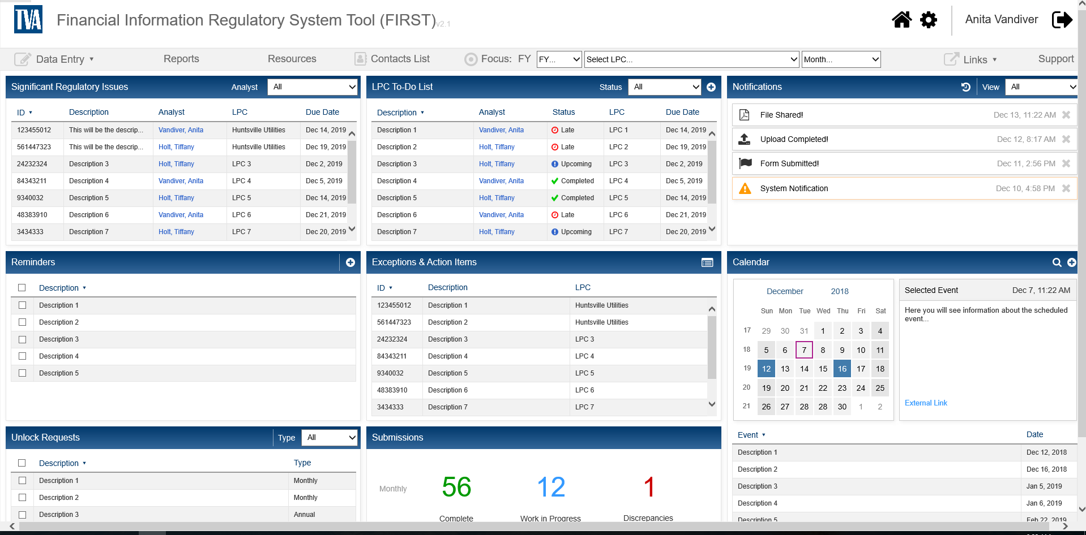
Dashboard
Notes:
Here’s an example of the Customizable Dashboard that I mentioned – YOU will be able to determine what you want to see on the dashboard – a lot of you wear different hats at your organizations and what’s important to one of you might not be important to another
You’ll have reminders such as due dates
Any action items that you have will be shown on the dashboard – so you won’t get panicked calls from Bill or me on the 25th saying we need to close something by the 30th – you’re welcome
So, this feels like a major improvement to me

Slide 7
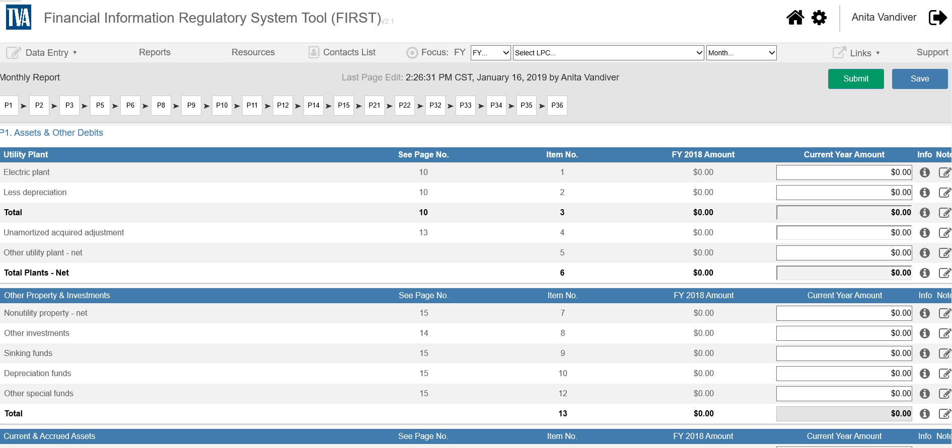
Monthly Reporting
Notes:
Here’s just an example of what the monthly reporting system will look like – as you can see it’s not a radical departure from what you’re used to – just a newer, cleaner look
A couple of items to point out:
It will now show you the previous years amount by line item, which should help you with comparisons, etc.
And if you look on the top, you’ll notice a LOT more pages – don’t let that scare you – there will be no additional requirements for monthly reporting – BUT, if you’d like to enter some of this information monthly, it will then roll over into the Annual Report for you, and hopefully make that process much smoother

Slide 8
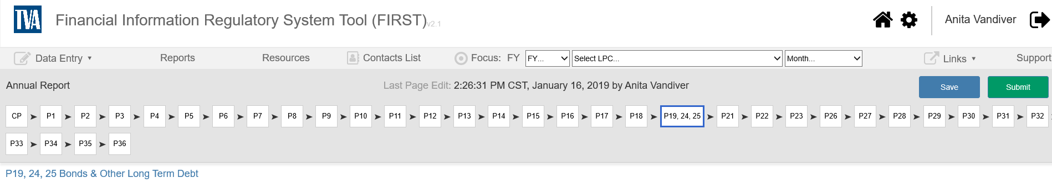
Page Navigation
Notes:
This is just an example of how you can navigate pages by a simple click – rather than going to that System Focus page that you all love so much

Slide 9
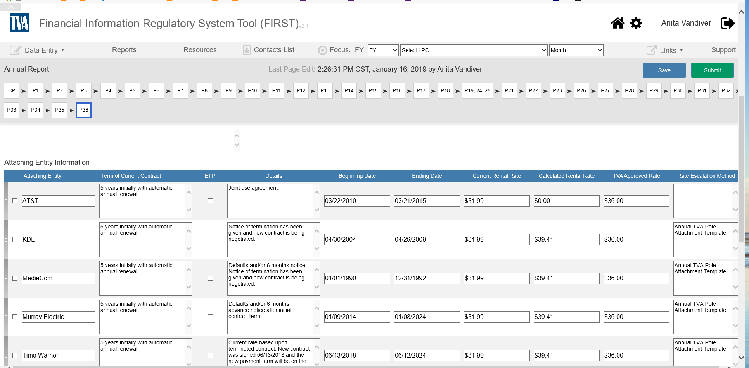
Pole Attachments
Notes:
The Pole Attachment page has been cleaned up – and that data will now roll forward from year-to-year, so that data should be much easier to enter/update

Slide 10
Early Feedback from FIRST Demo’s
Dashboard – LIKE IT
Data Validation – do not allow report to submit if it does not balance
Support additional internet browsers (i.e., Google Chrome)
Monthly reporting much improved
Monthly footnotes rolling to Annual is great, IF they can be easily edited
Excited about ESS Data integration
Like the navigational improvements, particularly on Bonds
Desire to create own graphical reports
Notes:
The FIRST team will be going around the Valley doing Demo’s and soliciting feedback – hopefully a lot of you were able to attend the one in MS last week
Here is some of the early feedback that we received – unfortunately I was not able to be there, but I have heard that it went really well
Here are some examples of the feedback from that demo:
People really liked the dashboard
The data validation is an improvement
There is a desire to be able to use different internet browsers – thank you to whoever said that, because I have been saying it for years
The reporting seems like an improvement
The like the footnotes rolling forward
There are some who desire to be able to use the system to produce their own graphs/charts, etc. – I do think that’s a wish that will be granted

Slide 11

Notes:
So, that’s all that I’ve got – I’ll be happy to take any questions or feedback that you have

